Slide 1
Dependable Distributed Systems
Master of Science in Engineering in Computer Science
AA 2026/2027
Lecture 12: Ordered communications

Slide 2
Ordered Communication
Define guarantees about the order of deliveries inside group of processes
FIFO Order
Causal Order
Total order (atomic communication)

Slide 3
Advantages of ordered communication
Orthogonal wrt reliable communication.
  Reliable broadcast does not have any property on ordering deliveries of messages
This can cause anomalies in many applicative contexts
“Reliable ordered communication” are obtained adding one or more ordering properties to reliable communication
“reserve
a seat”
“cancel
my reservation”
client
t
The server cancelled a reservation that has never been done!
server
“Prices
15% off”

Slide 4
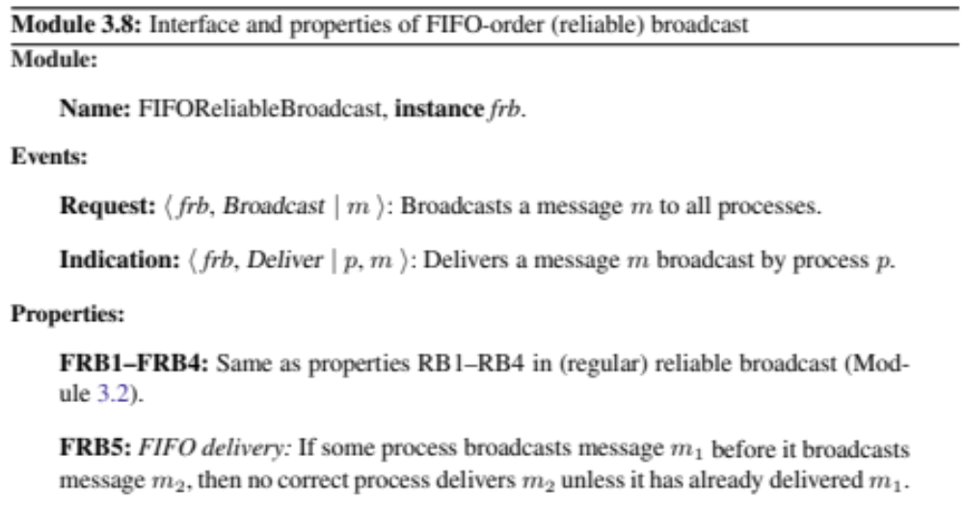
FIFO Broadcast - Specification
FIFO Broadcast can be uniform/non uniform
Broadcast (msg)
Deliver(msg)
FIFO Broadcast
Same as Reliable Broadcast (URB for Uniform FIFO Broadcast
FIFO Order

Slide 5
Example
m1
m2
m1
m2
m3
m1
m3
m2
FIFO Uniform Reliable
m3
m1
m2
m3
m1
m2
m1
m2
m1
m2
FIFO (Regular) Reliable
m3
m1
m2
m3

Slide 6
Example
m1
m2
m1
m2
m3
m1
m3
FIFO (Regular) Reliable
m3
m1
m3
m1
m2
m1
m2
m1
m2
Not Reliable but it satisfies FIFO Order
m3
m1
m2
m3

Slide 7
Example
m1
m2
m1
m2
m3
m2
m3
Reliable Broadcast but not FIFO Broadcast
m3
m2
m3
m1
m2
m3
m2
m3
m2
Uniform Reliable Broadcast but not FIFO Broadcast
m3
m2
m3

Slide 8
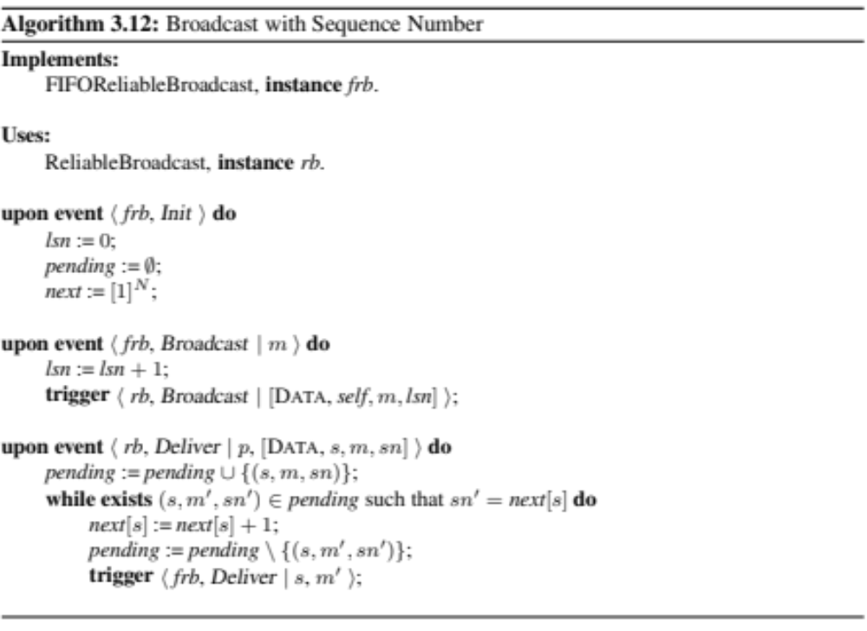
FIFO Broadcast - Implementation
FIFO_Broadcast (m)
FIFO_Deliver(s,m)
FIFO Broadcast
Broadcast (m)
Deliver(s,m)
RB

Slide 9
Example 1
Next₁=
Next₁=
2 | 1 | 1
3 | 1 | 1
m1
m1
m2
m2
lsn₁=1
lsn₁=2
<P1, m2, 2>
<P1, m1, 1>
Next₂=
2 | 1 | 1
m1
m2
Next₂=
Pending={<p1, m2, 2>}
3 | 1 | 1
Pending={}
m1
m2
lsn=0
Pending={}
Next =
Next₃=
2 | 1 | 1
Next₃=
3 | 1 | 1
1 | 1 | 1

Slide 10
Example 2
Next₁=
Next₁=
2 | 1 | 1
3 | 1 | 1
m1
m1
m2
m2
lsn₁=1
lsn₁=2
<P1, m2, 2>
<P1, m1, 1>
Pending={<p1, m2, 2>}
lsn=0
Pending={}
Next =
Pending={<p1, m2, 2>}
1 | 1 | 1

Slide 11
Example 3
Next₁=
Next₁=
2 | 1 | 1
3 | 1 | 1
m1
m1
m2
m2
lsn₁=1
lsn₁=2
<P1, m2, 2>
<P1, m1, 1>
Next₂=
2 | 1 | 1
m1
m1
lsn=0
Pending={}
Next =
Next₃=
2 | 1 | 1
1 | 1 | 1

Slide 12
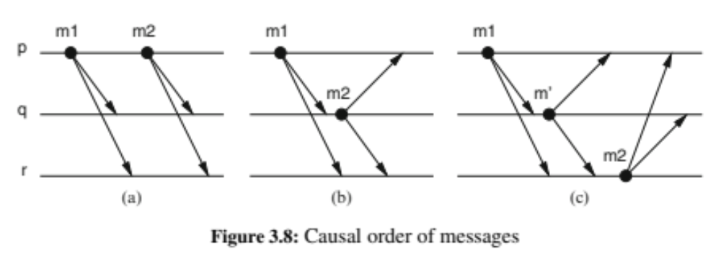
Causal Order Broadcast
Ensures that messages are delivered according to the cause–effect relationships
  Causal order is an extension of the happened-before relation
A message m₁ may have potentially caused another message m₂ (denoted as m₁ → m₂) if any of the following holds:
  some process p broadcasts m₁ before it broadcasts m₂
  some process p delivers m₁ and subsequently broadcasts m₂
  there exists some message m′ such that m₁ → m′ and m′ → m₂

Slide 13
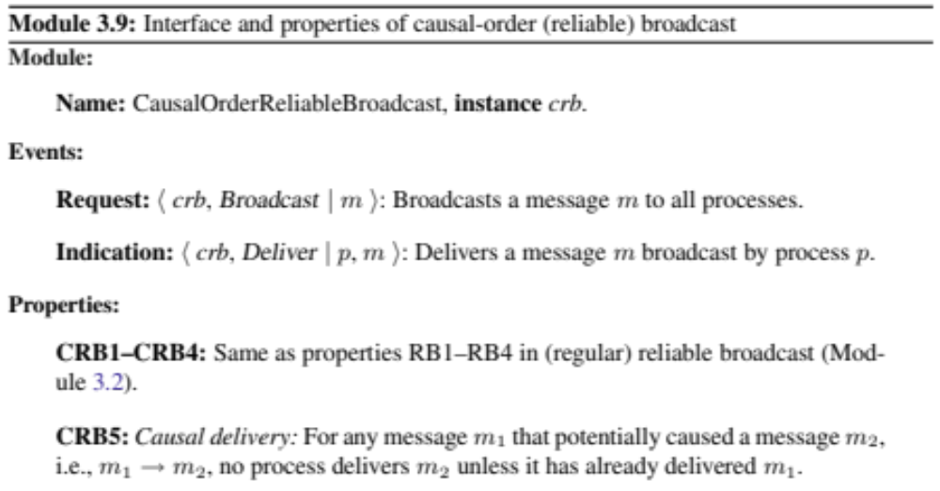
Causal Order Broadcast Specification
Causal Order Broadcast can be uniform/non uniform
CO_Broadcast (m)
CO_Deliver(m)
Causal Order Broadcast
Same as Reliable Broadcast (URB for Uniform FIFO Broadcast
Causal Order

Slide 14
Causal Order Broadcast
Observation
  Causal Broadcast = Reliable Broadcast + Causal Order
    Causal Order ⟹ FIFO Order
    But FIFO Order ⇏ Causal Order
  Causal Order = FIFO Order + Local Order
    Local Order: if a process delivers a message m_a before sending a message m_b, then no correct process deliver m_b if it has not already delivered m_a

Slide 15
Example 1
m3
m1
m2
m1
m2
FIFO Reliable but Not Causal
m1
m2
m3
m1
m3
m2
m3
To have causal we need
m1 -> m2 (FIFO)
m1 -> m3 (local Order)

Slide 16
Example 2
m1
m3
m2
m1
m2
Causal Reliable
m1
m2
m3
m1
m3
m2
m3
To have causal we need
m1 -> m2 (FIFO)
m1 -> m3 (local Order)
m1, m2, m3
m1, m3, m2

Slide 17
Example 3
m1
m2
m3
m1
m2
Causal Reliable
m1
m2
m3
m1
m2
m3
m3
To have causal we need
m1 -> m2 (FIFO)
m2 -> m3 (local Order)
m1, m2, m3

Slide 18
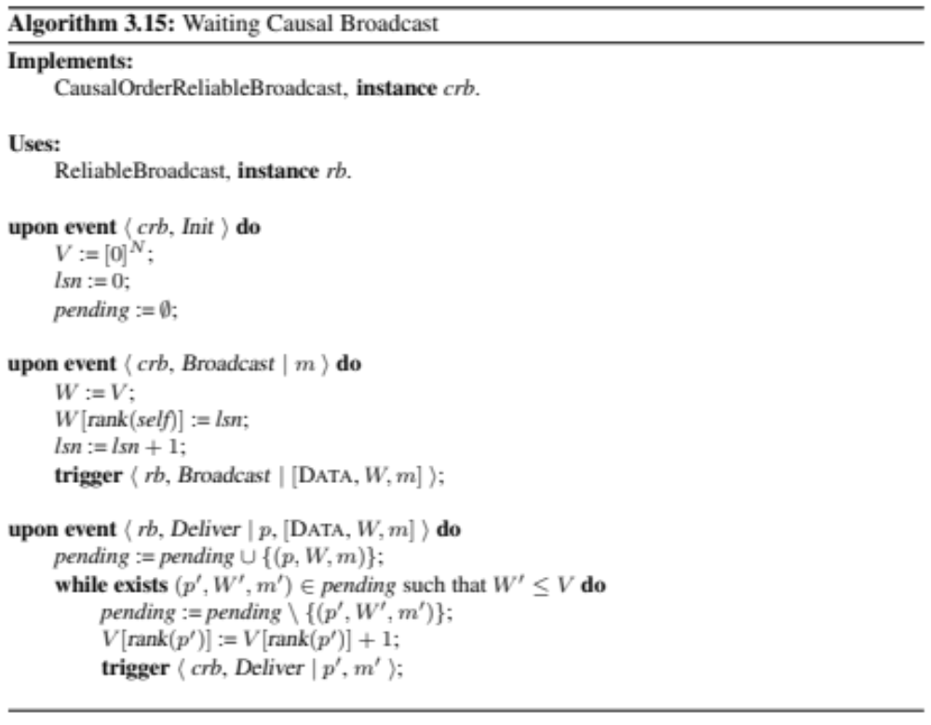
Causal Order Broadcast Implementation
CO_Broadcast (m)
CO_Deliver(s,m)
Causal Order Broadcast
The function rank() associates an entry of the vector to each process
Broadcast (m)
Deliver(s,m)
RB

Slide 19
Waiting Causal Broadcast example
0
1
1
m₂
0
0
m₁
0
p₁
0
m₁
0
1
0
1
1
1
0
0
0
m₁
0
m₂
p₂
0
0
0
1
0
1
1
When m₂ arrives
V₂ > m.VC
then p₂ delays the delivery
m₁
m₂
0
0
0
p₃
0
0
m₂
1
V[]

Slide 20
Causal Order Broadcast: Safety
Property:
  Let two broadcast messages m and m’ such that broadcast(m) → broadcast(m’) then each process have to deliver m before m’
Observation:
  if m is the k-th message sent by p_{i} then m.Vc[ i ]= k-1
Safety property can be proved by induction using the causal ordering relation among broadcast messages
Definition:
  Let two broadcast events b and b’ with b → b’. These events have a causal distance k if ∃ a sequence of k broadcast events b₁ … b_{k} such that
    ∀ I ∈ {1… k } b_{i} → b_{i+1} ∧ (¬∃) m* | b_{i} → m* → b_{i+1}
    b → b₁
    b_{k} → b’

Slide 21
Proof – basic case (K=0)
Given two messages m, m’ such that
  broadcast(m) → broadcast(m’)
  There does not exists broadcast(m’’) such that
  broadcast(m) → broadcast(m’’) ∧ broadcast(m’’) → broadcast(m’).
We can have two distinct cases
  m and m’ have been issued by the same process
  m and m’ have been issued by distinct processes

Slide 22
Case 1 – brodacast produced by the same process
p_{j} is the receiver
For line 3 in broadcast procedure
  m’.VC[i]:= m.VC[i]+1.
  if m is the h-th message sent by p_{i}, m.VC[i]=h-1 and m’.VC[i]=h.
A process p_{j} that receives m’ verifies the following delivery condition:
  ∀ x ∈ {1,…,n} m’.VC[x] ≤ V_{j}[x] and m’.VC[i] ≤ V_{j}[i]
V_{i}[x] is equals to h if and only if the h-th message sent by p_{x} was delivered by p_{i}. (line 3 receive thread).
Consequently from 2,3,4, m’ can be delivered only after the deliver of m.

Slide 23
Case 2 – brodacast produced by distinct processes
m and m’ was been sent by distinct processes, respectively p_{i} e p_{j}. p_{k} is the receiver.
broadcast(m) → broadcast(m´), m’ was broadcasted by p_{j} after the deliver of m.
Without loss of generality m.VC[i]=h-1
  For line 3 of reception thread e for assumption of k=0 we have m’.VC[i]=h.
The receiver process p_{k} respects the following delivery condition:
  ∀ x ∈ {1,…,n} m’.VC[x] ≤ V_{k}[x] and m’.VC[i] ≤ V_{k}[i]
To deliver the message, m’.VC[i] ≤ V_{k}[i], that is V_{k}[i] ≥ h
V_{k}[i] is equals to h if and only if the h-th message sent by p_{i} has been delivered by p_{k}. (line 3 of reception thread thread).
For 2,3,4, p_{k} can deliver m’ only after the deliver of m

Slide 24
Proof – Inductive step(k>0)
∃ a sequence of k broadcast events b₁, b₂ … b_{k} such that
  b → b₁ → b₂ → … → b_{k} → b’
Inductive hypothesis : m has been delivered before m_{k}
We have to prove that m_{k} has been delivered before m’.
  It follows from the basic case.
m has been delivered before m’.

Slide 25
Causal Order Broadcast: Liveness
Property:
  Eventually each message will be delivered
Liveness is guaranteed by the following assumptions:
  The number of broadcast events that precedes a certain event is finite
  Channels are reliable

Slide 26
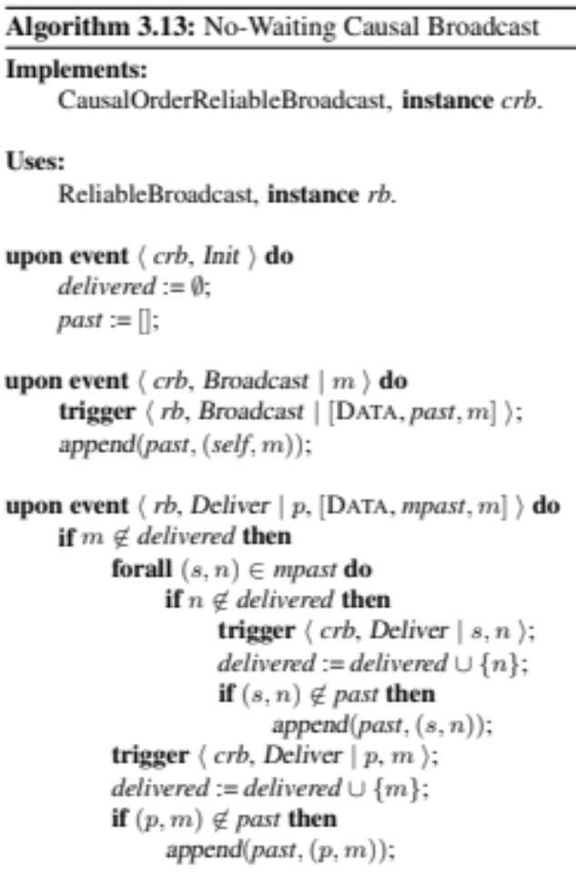
Causal Order Broadcast Implementation
CO_Broadcast (m)
CO_Deliver(s,m)
append(L, x) adds an element x at the end of list L
Causal Order Broadcast
(implicit assumption) No two processes broadcast the same m
Broadcast (m)
Deliver(s,m)
by the order in the list
RB

Slide 27
Non-Waiting Causal Broadcast example
p₁ is already aware of <p₁, m₁> so it just delivers m₂
m₁
m₂
p₁
m₁
p₂ is not aware of <p₁, m₁> but it got it through m₂…
So, it will deliver both m₁ and m₂
m₁
m₂
p₂
<p₁, m₁> is sent together with m₂
p₂ already delivered m₂ so it discards it
<p₁, m₁> is added to past
m₁
m₂
p₃
m₂

Slide 28
Advantages of Ordered Communication
  Causal Order is not enough strong to avoid anomalies
  E.g. Bank account replicated on two sites
Deposit
£20
A:£100
A:£120
A:£132
R₁
R₂
A:£100
Add 10%
interest
A:£110
A:£130
same initial state, different final state at the two sites
To have the same final state we need to ensure that the order of deliveries is the same at each process.
Note that ensuring the same delivery order at each replicas does not consider the sending order of messages

Slide 29
Total Order Broadcast
A total-order (reliable) broadcast abstraction orders all messages, even those from different senders and those that are not causally related
Reliable Broadcast + Total Order
The total-order broadcast abstraction is sometimes also called atomic broadcast
message delivery occurs as if the broadcast were an indivisible “atomic” action
the message is delivered to all or to none of the processes and, if the message is delivered, every other message is ordered either before or after this message.
processes agree on the same set of messages they deliver
Processes agree on the same sequence of messages

Slide 30
Total Order Broadcast
Total order is orthogonal with respect to FIFO and Causal Order.
Total order would accept indeed a computation in which a process p_{i} sends n messages to a group, and each of the processes of the group delivers such messages in the reverse order of their sending.
- The computation is totally ordered but it is not FIFO.

Slide 31
Relationship between Broadcast Specifications
Reliable
broadcast
Total Order
Atomic
broadcast
FIFO Order
FIFO Order
FIFO
broadcast
Total Order
FIFO Atomic
broadcast
Causal Order
Causal Order
Local Order
Local Order
Causal
broadcast
Total Order
Causal Atomic
broadcast

Slide 32
Let’s Identify
Total Order
Execution 3
Execution 4
Causal Reliable Broadcast
FIFO Reliable Broadcast
Reliable Broadcast
Execution 1
Execution 2

Slide 33
Execution 1
m1
m2
m2
m1
m4
m3
Reliable, Total, not FIFO
FIFO Order
m1 -> m2
m3 -> m4
m2
m1
m4
m3
m3
m4
m2
m1
m4
m3

Slide 34
Execution 2
m1
m2
m2
m1
m4
m3
Reliable, not total, not FIFO
FIFO Order
m1 -> m2
m3 -> m4
m2
m1
m4
m3
m3
m4
m4
m3
m2
m1

Slide 35
Execution 3
m3
m1
m2
Total, FIFO, Not Causal
m1
m2
Ordering Relationships
m1 -> m2 (FIFO order)
m1 -> m3 (local order)
m1
m3
m3
m1
m2

Slide 36
Execution 4
m1
m2
m3
m1
m2
Total, FIFO, Causal
m1
Ordering Relationships
m1 -> m2 (FIFO order)
m1 -> m3 (local order)
m1, m2, m3
m1, m3, m2
m3
m2
m3
m1
m2
m3

Slide 37
Exercise
Provide all the delivery sequences such that both total order and causal order are satisfied.
m1
m1
m2
Broadcast
m2
Deliver
m3
m4

Slide 38
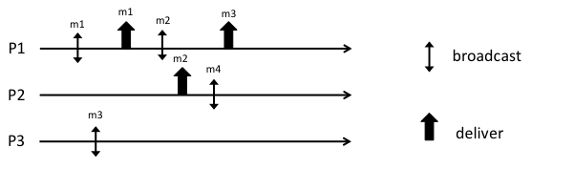
Exercise
Provide all the possible sequences satisfying Causal Order
Complete the execution in order to have a run satisfying FIFO order but not causal order

Slide 39
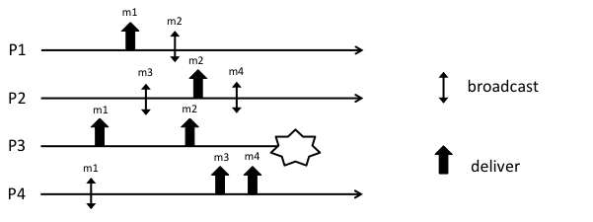
Exercise
Provide the list al all the possible delivery sequences that satisfy both Total Order and Causal Order
Complete the history (by adding the missing delivery events) in order to satisfy Total Order but not Causal Order
Complete the history (by adding the missing delivery events) in order to satisfy FIFO Order but not Causal Order nor Total Order

Slide 40
References
C. Cachin, R. Guerraoui and L. Rodrigues. Introduction to Reliable and Secure Distributed Programming, Springer, 2011
  Chapter 3 - from Section 3.9 (except 3.9.6)

